Slide 1
Class Relationships and Reuse
C++ Interlude 5
© 2017 Pearson Education, Hoboken, NJ. All rights reserved

Slide 2
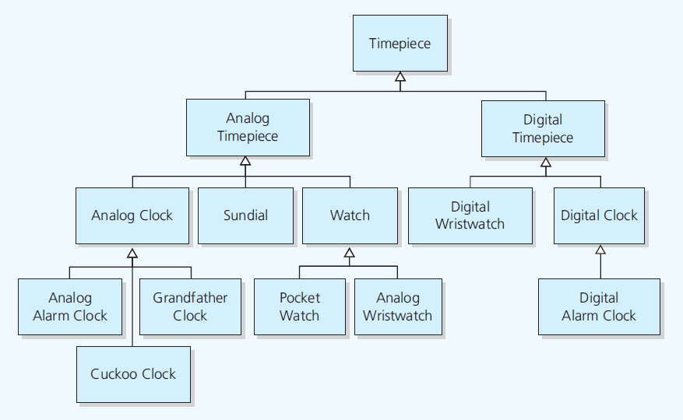
Inheritance Revisited
Figure C5-1 Inheritance: Relationships among timepieces
© 2017 Pearson Education, Hoboken, NJ. All rights reserved

Slide 3
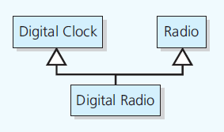
Inheritance Revisited
Figure C5-2 Multiple inheritance
© 2017 Pearson Education, Hoboken, NJ. All rights reserved

Slide 4
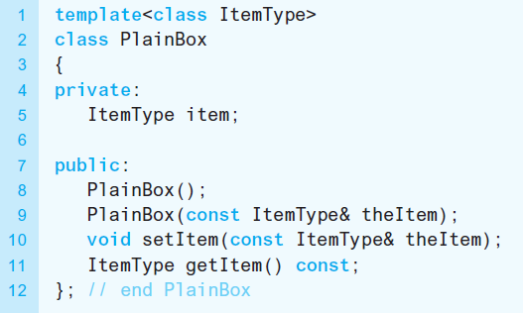
Inheritance Revisited
Listing C5-1 The class PlainBox, originally given in Listing C1-3
© 2017 Pearson Education, Hoboken, NJ. All rights reserved

Slide 5
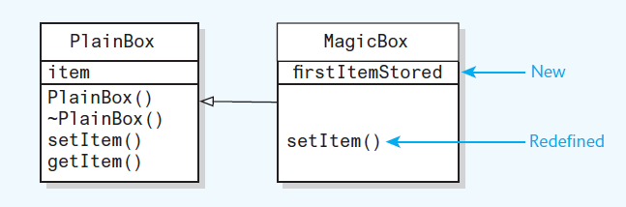
Inheritance Revisited
Figure C5-3 The derived class MagicBox inherits members of the base class PlainBox and redefines and adds members
© 2017 Pearson Education, Hoboken, NJ. All rights reserved

Slide 6
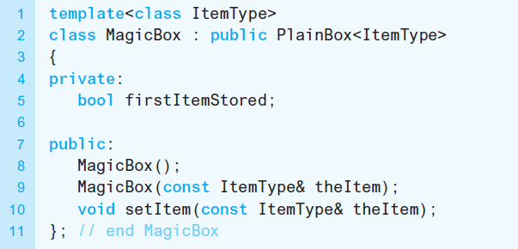
Inheritance Revisited
Listing C5-2 The class MagicBox, originally given in Listing C1-7
© 2017 Pearson Education, Hoboken, NJ. All rights reserved

Slide 7
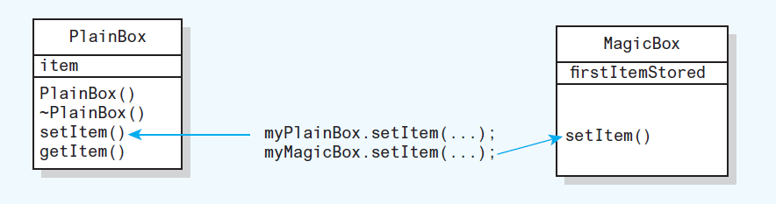
Inheritance Revisited
Figure C5-4 Early, or static, binding: The compiler determines which version of a method to invoke
© 2017 Pearson Education, Hoboken, NJ. All rights reserved

Slide 8
Inheritance Revisited
Late binding
  The appropriate version of a method decided at execution time
Polymorphic method has multiple meanings
Virtual method can be overridden
Virtual method in a base class
  Virtual in any derived class
© 2017 Pearson Education, Hoboken, NJ. All rights reserved

Slide 9
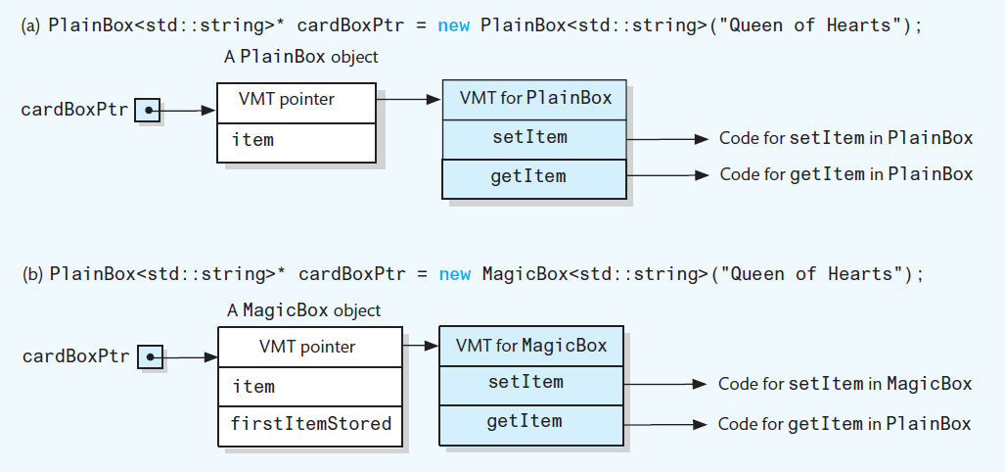
Inheritance Revisited
Figure C5-5 Virtual method tables when cardBoxPtr points to an instance of either PlainBox or MagicBox
© 2017 Pearson Education, Hoboken, NJ. All rights reserved

Slide 10
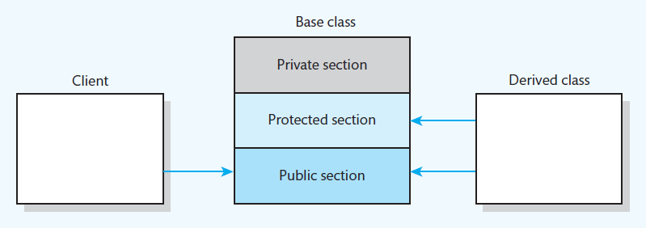
Public, Private, and Protected Sections of a Class
Figure C5-6 Access to public, private, and protected
sections of a class by a client and a derived class
© 2017 Pearson Education, Hoboken, NJ. All rights reserved

Slide 11
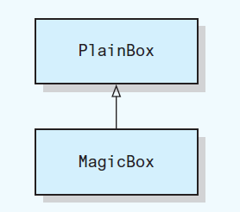
Public, Private, and
Protected Inheritance
Figure C5-7 A magic box is a plain box
© 2017 Pearson Education, Hoboken, NJ. All rights reserved

Slide 12
Public, Private, and
Protected Inheritance
Public inheritance
  Implements is-a relationship
  Use instance of a derived class anywhere you can use an instance of base class
If relationship not is-a
  Do not use public inheritance
© 2017 Pearson Education, Hoboken, NJ. All rights reserved

Slide 13
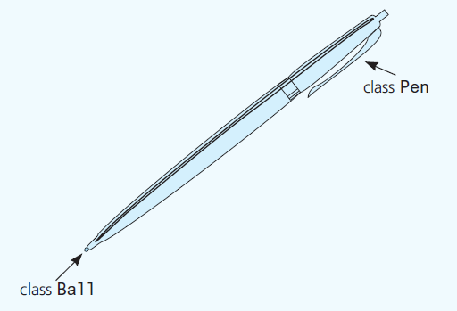
Containment: Has-a Relationships
Figure C5-8 A pen has a or contains a ball
© 2017 Pearson Education, Hoboken, NJ. All rights reserved

Slide 14
Containment: Has-a Relationships
Has-a or containment
  Means a class has an object as a data member
Execution order of constructors for both inheritance and containment
  Its base class constructor executes.
  Constructors of its member objects execute in the declaration order.
  The body of its constructor executes.
© 2017 Pearson Education, Hoboken, NJ. All rights reserved

Slide 15
Containment: Has-a Relationships
Execution order of destructors for both inheritance and containment
  The body of its destructor executes.
  Destructors of its member objects execute in the declaration order.
  Its base class destructor executes.
© 2017 Pearson Education, Hoboken, NJ. All rights reserved

Slide 16
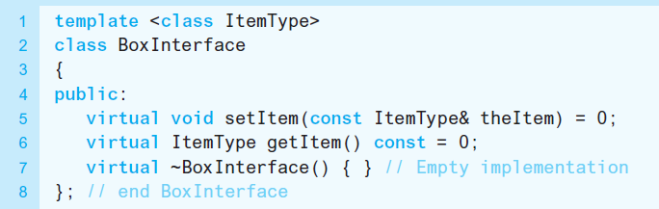
Abstract Base Classes Revisited
Abstract base class
  Contains at least one pure virtual method
  Has descendants but no instances
Listing C5-3 An abstract class that is an
interface for the ADT box
© 2017 Pearson Education, Hoboken, NJ. All rights reserved

Slide 17
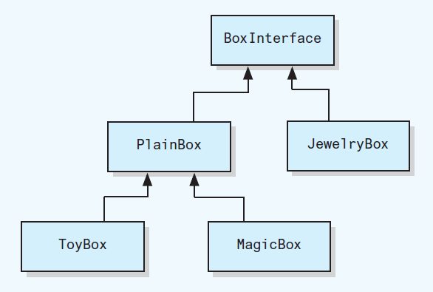
Abstract Base Classes Revisited
Figure C5-9 UML class diagram of the family of box classes
© 2017 Pearson Education, Hoboken, NJ. All rights reserved

Slide 18
End
C++ Interlude 5
© 2017 Pearson Education, Hoboken, NJ. All rights reserved

